Slide 1
DCDSL PROJECT AY 2024-25
Phase 2 Presentation
Title of the Project: SQL-Based Analysis of Social Network Data
Group Members:
Alabhya Sharma (23070126010)
Amannyu Gondkar (23070126011)
Anusri Kadam (23070126016)
Practical Batch: A1
Subject Teacher
Prof. Archana Chaudari

Slide 2
Outline of the Presentation
Names of all the group members and their work distribution
Introduction
Problem Statement
Objectives of the Project
Methodology
ER Diagram
ER Diagram To Relational Schema Conversion
Database Table Creation and Data Insertion
Basic and Advanced Query Implementation
Python Desktop / Web Application
Project Outcome
Conclusion
References
A photograph of the phase 1 presentation.

Slide 3
Group Members and Work Distribution
Alabhya Sharma ,Anusri Kadam - ER Diagram Design, ER to Relational Schema Conversion
Amannyu Gondkar- Database Table Creation, Data Insertion
Amannyu Gondkar ,Anusri Kadam - Query Implementation (Basic and Advanced SQL Queries)
Amannyu Gondkar- Python Application Development (Desktop/Web Interface)
Alabhya Sharma, Anusri Kadam - Documentation, Report Writing, and Presentation Preparation

Slide 4
Introduction
Social media has altered the way people interact, exchange information, and connect across the globe. It is a bustling platform for conversations, trendsetting, and community development, generating massive volumes of data on a daily basis. Analyzing social media information provides insights into user behavior, sentiments, and trending themes, which reflect society's interests. Understanding these dynamics is critical for businesses and organizations that want to communicate effectively with their audiences. This data provides opportunity to optimize tactics, improve user experiences, and respond to new trends in real time.

Slide 5

Problem Statement
This project aims to analyze social network data using SQL, focusing on user profiles and their follower relationships. Through SQL queries, we will extract insights into user behavior, connection patterns, and profile attributes to better understand the dynamics within the dataset.

Slide 6
Objectives of the project
To Design and Implement a Database Schema
Develop an efficient and scalable database structure that supports a social media application, including tables for users, photos, comments, likes, follows, and tags, while ensuring data integrity through appropriate constraints and relationships.
To Develop CRUD Operations for Managing Social Media Data
Implement Create, Read, Update, and Delete (CRUD) operations for core features such as user profiles, photo uploads, comments, likes, and followers to enable dynamic interaction and management of data within the system.
To Provide a User-Friendly Interface for Data Interaction
Build a simple and intuitive graphical user interface (GUI) using Tkinter, allowing users to interact with the social media data through operations such as posting photos, commenting, liking posts, and managing their profiles.
To Ensure Efficient Data Retrieval and Management
Optimize SQL queries for faster data retrieval and handling of large datasets, especially for features like searching for photos, finding users, and listing tags, ensuring quick and seamless user interactions.

Slide 7
Methodology
Data Collection and Preparation:
-Load and clean the social network data to ensure consistency across tables.
-Integrate tables like users, follows, photos, comments, likes, and hashtags to create a cohesive dataset that connects user profiles to their content and interactions.
Database Design:
-Design an Entity-Relationship (ER) schema based on the project requirements. Define relationships among entities like users, photos, comments, hashtags, and follows.
-Establish necessary indexes and foreign keys to optimize query performance and data retrieval across related tables.

Slide 8
Methodology
Data Analysis Using SQL Queries:
-User Profile Analysis: Use SQL queries to analyze user attributes such as account age, content posted, and follower/followee counts.
-Connection and Engagement Patterns: Extract patterns in follows, likes, and comments to assess user engagement with the content.
-Content and Hashtag Insights: Identify trending hashtags, popular content, and tagging frequency using photo_tags and hashtags tables.
Data Interpretation and Reporting:
-Interpret query results to derive insights on user behavior and interaction dynamics.
-Visualize key findings, such as engagement patterns and follower networks, to present a comprehensive analysis.
-Provide recommendations based on the data, such as ways to enhance user engagement or identify influential users for targeted marketing.

Slide 9
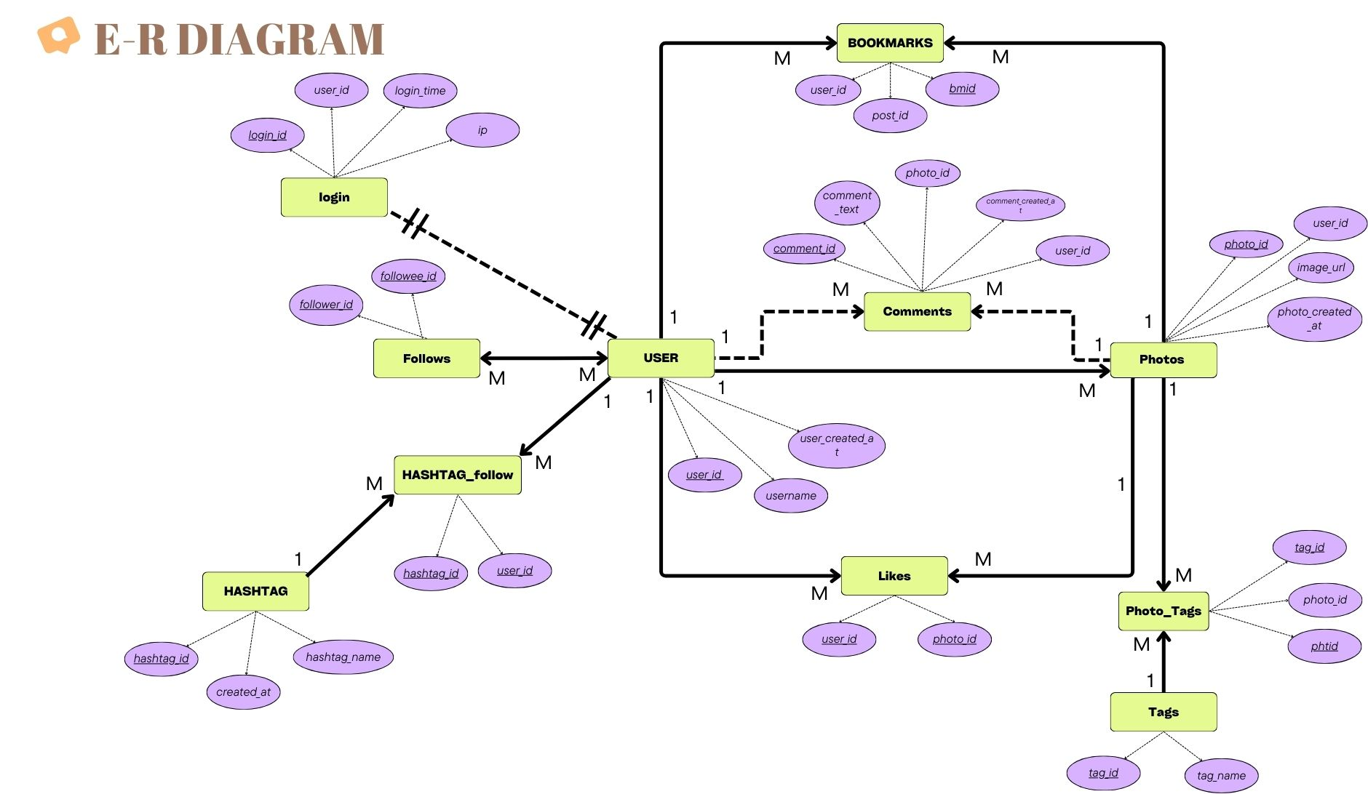

Slide 10
ER diagram to Relational Schema Conversion
users (user_id , username, user_created_at)
photos (photo_id, image_url, user_id, photo_created_at)
comments(comment_id,comment_text,user_id,photo_id, comment_created_at)
likes (user_id, photo_id)
follows (follower_id, followee_id)
tags (tag_id, tag_name)
photo_tags (phtid, photo_id, tag_id)
login (login_id, user_id, ip, login_time)
hashtags (hashtag_id, hashtag_name, created_at)
hashtag_follow (user_id, hashtag_id)
bookmarks (bmid, post_id, user_id)

Slide 11
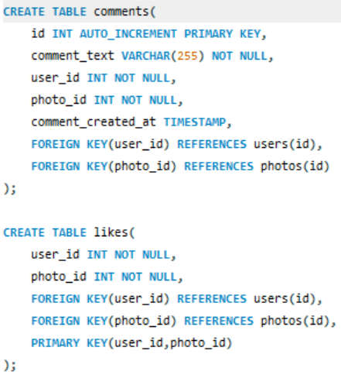
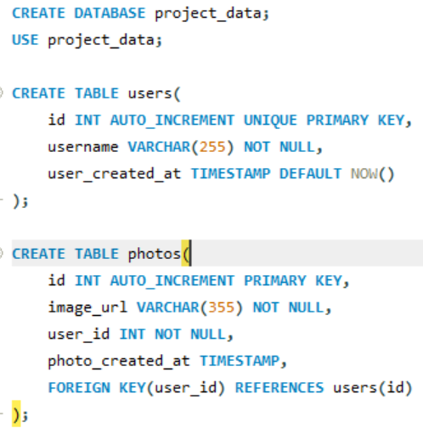
Database Table Creation and Data Insertion
SQL commands for tables and inserting sample data into the users, photos, comments, likes, follows, tags, photo_tags, login, hashtags, and hashtag_follow tables.

Slide 12
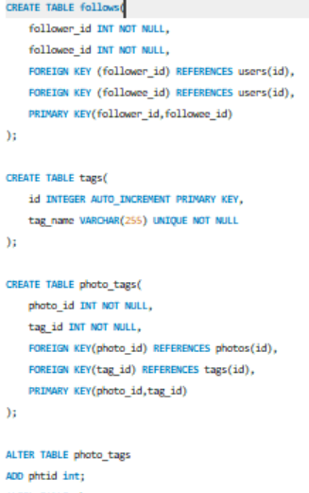
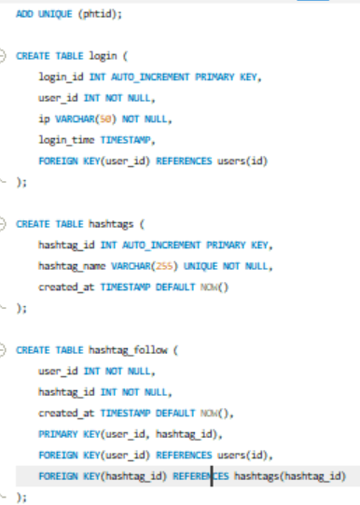

Slide 13
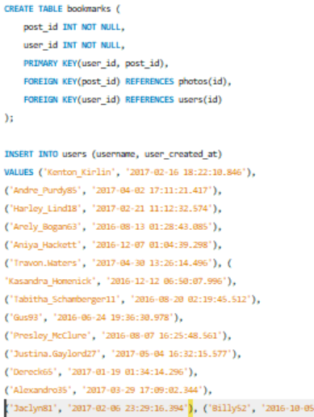
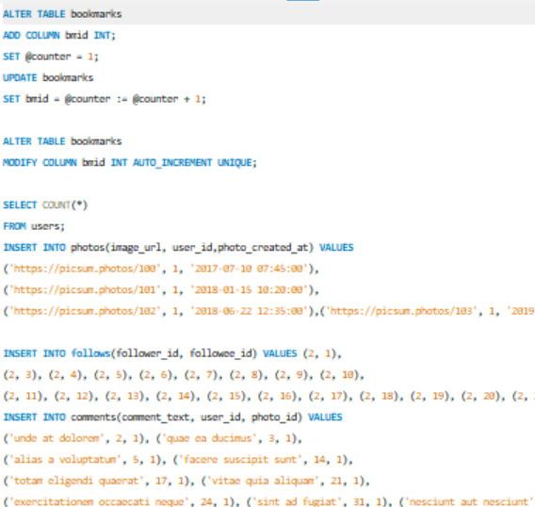
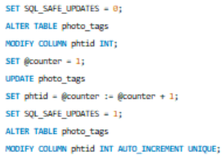

Slide 14
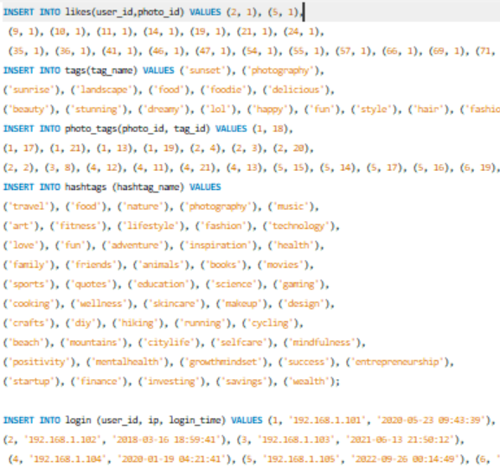
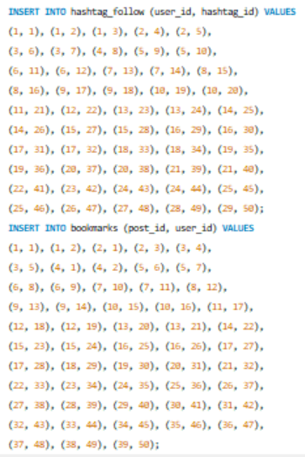

Slide 15
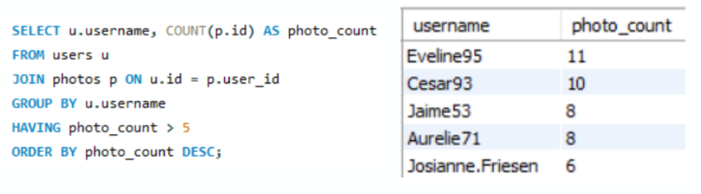
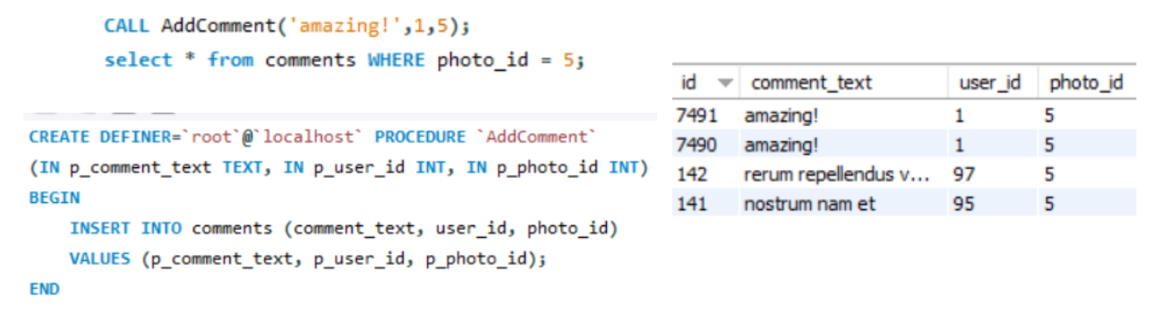
Basic and Advanced Query Implementation
Write a query to find which users have posted more than 5 photos?
2. Create a stored procedure to add a new comment for a photo.

Slide 16
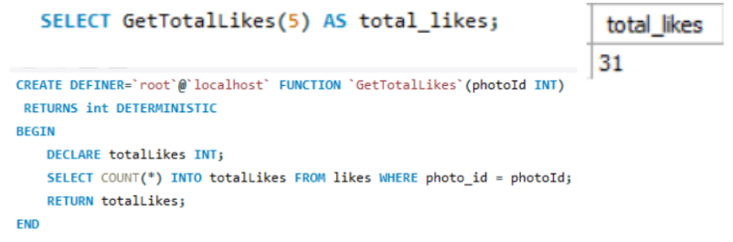
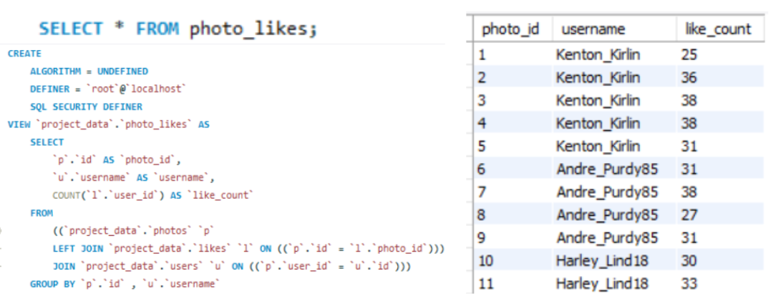
3. Create a function that returns the total number of likes for a specific photo.
4.Create a view that displays the total likes for each photo along with the username of the user who posted it.

Slide 17

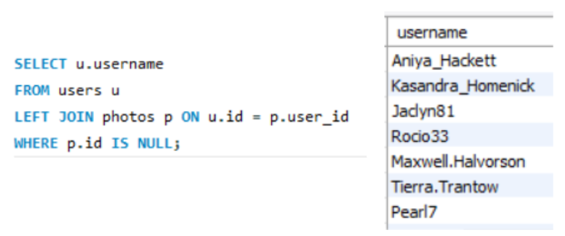
5.How many photos were uploaded in the last 3 years?
6.Find users who haven't uploaded any photos

Slide 18
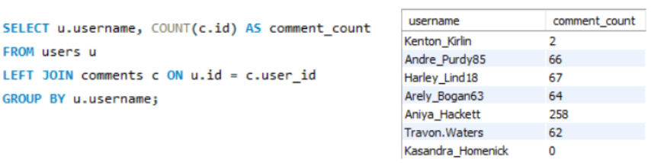
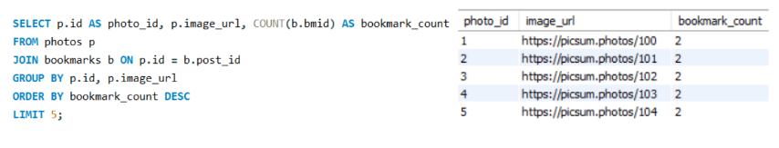
8.What is the count of comments each user has made on photos?
9.Find the Top 5 Most Bookmarked Photos.

Slide 19
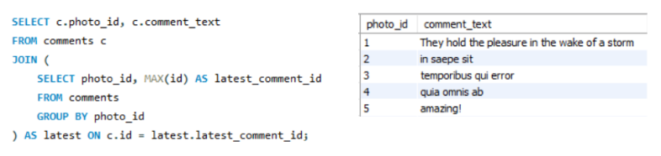
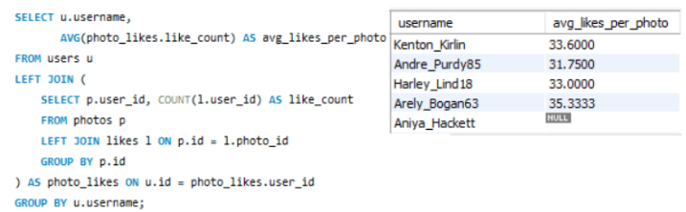
10.Write a query to get the Most Recent Comment for Each Photo.
11.Find the Average Number of Likes Per User’s Photo

Slide 20
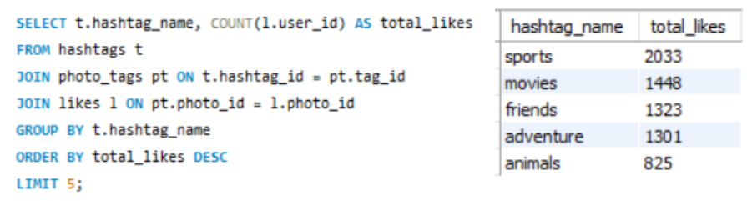
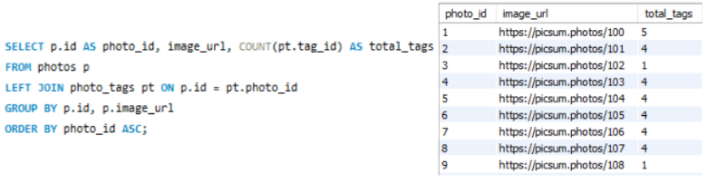
12.List top 5 most Liked Hashtags along with the count of likes.
13.List All Photos Along with the Total Number of Hashtags Assigned to Them.

Slide 21
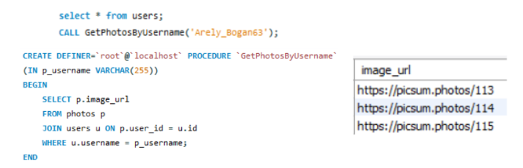
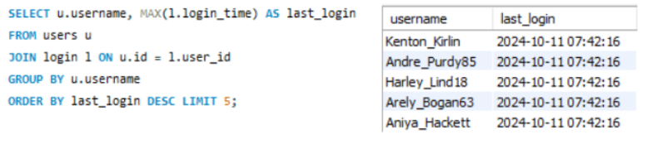
14.Write a procedure to list all photos posted by a specific user.
15.Find the Most Recent Logins (top 5).

Slide 22
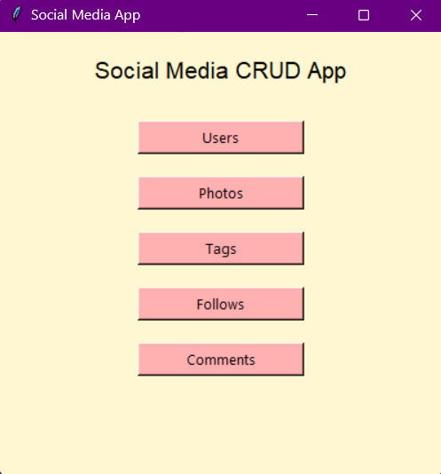
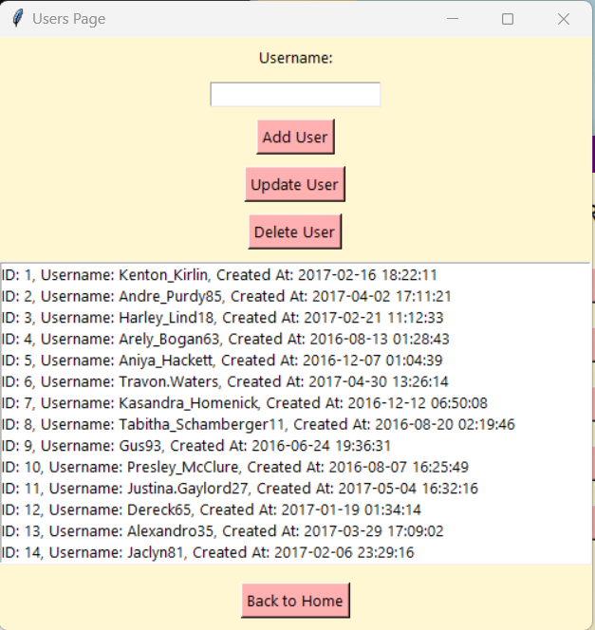
Python Desktop / Web Application
A Python-based [desktop/web] application was developed to provide an interactive interface for end-users to manage and view data. The application allows users to perform CRUD operations and view reports based on advanced queries."
libraries used : Tkinter for desktop.

Slide 23
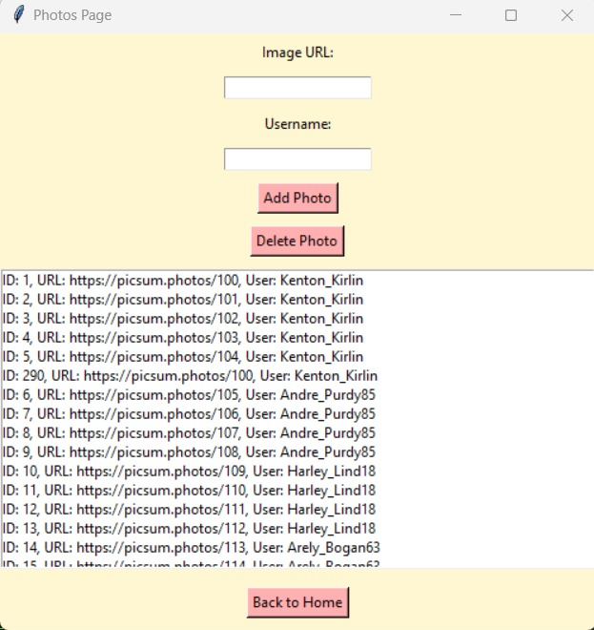
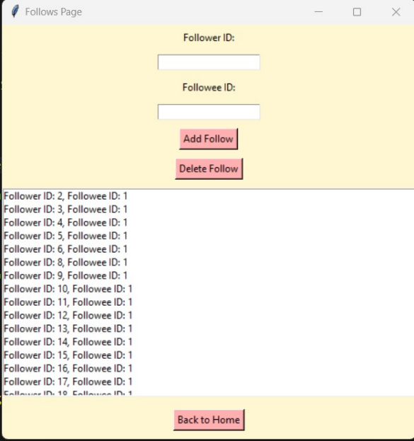
Python Desktop / Web Application

Slide 24
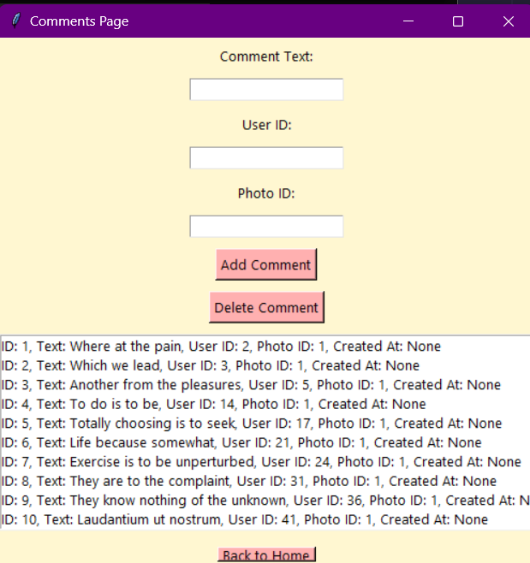
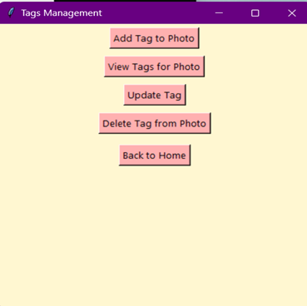
Python Desktop / Web Application

Slide 25
Project Outcome
Created a relational database system with a well-structured ER diagram and relational schema to capture essential entities and relationships.
Populated the database with realistic data, enabling both simple and complex SQL queries for real-world data manipulation.
Developed a Python-based application as a user-friendly interface for CRUD operations, eliminating direct database interaction.
Implemented advanced queries (multi-table joins, subqueries) to meet complex data retrieval needs and provide detailed insights.
Designed with scalability in mind, allowing for future enhancements such as data visualization, reporting, and cloud integration.
Technical Highlights:
Optimized database with indexing and constraints for data integrity and efficiency.
Integrated Python for seamless database interaction.

Slide 26
Conclusion
Project Impact:
This project showcases the effectiveness of combining databases with application development to solve data management challenges. By integrating SQL for robust data storage and retrieval with Python for the application interface, we achieved a solution that provides a structured backend and an intuitive frontend experience. This highlights the synergy between backend data handling and frontend accessibility, demonstrating the value of a user-centered design.
Potential for Future Development:
The project can be expanded to support multi-user environments, real-time data updates, and mobile app compatibility. Migrating the database to a cloud platform could enhance accessibility across devices and locations. Future iterations could also focus on strengthening data security, adding data visualization tools for better insights, and implementing automated backup and recovery features to enhance reliability and usability.

Slide 27
References
Books and Documentation:
Python Crash Course by Eric Matthes – Used for learning Python programming fundamentals, especially for connecting Python with SQL databases.
Web Resources:
Official MySQL Documentation (https://dev.mysql.com/doc/) – Referred for syntax and database management functionalities.
Dataset source (https://www.kaggle.com/datasets/sanjanamurthy392/instagram-user-analysis?resource=download)
Software Tools:
MySQL Workbench – Used for designing the database schema and executing SQL queries.
Python IDE (such as PyCharm or Visual Studio Code) – Utilized for coding the Python application and testing the interface.

Slide 28
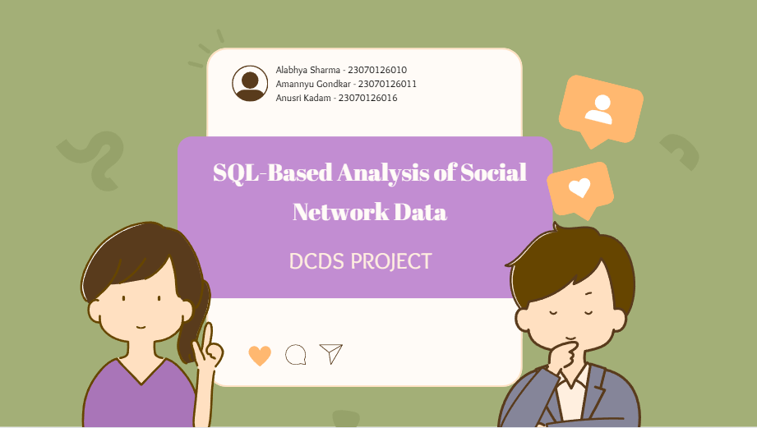
A photograph of the phase 1 presentation.

Slide 29
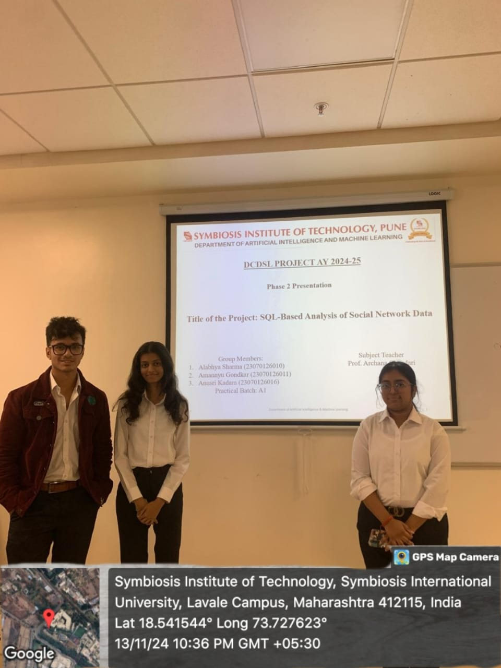
A photograph of the phase 2 presentation.

